Slide 1
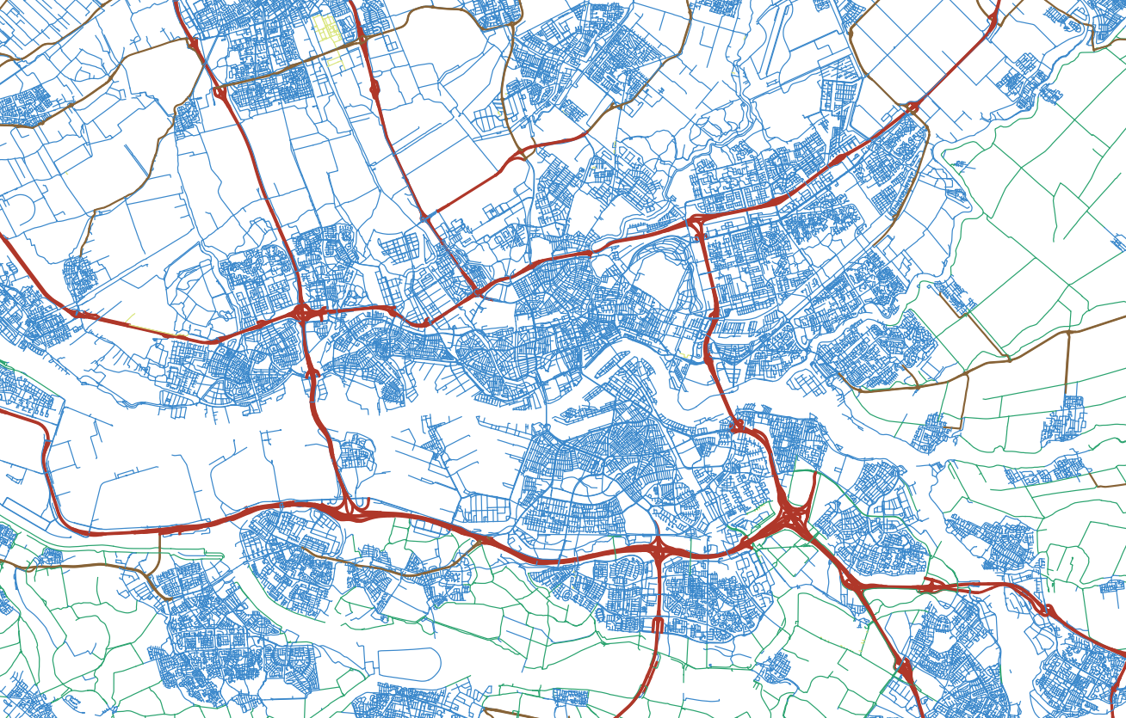

MSc Graduation Plan (P2) in Geomatics Constructing a digital 3D road network for The Netherlands
Kristof Kenesei Student 5142334 K.Kenesei@student.tudelft.nl
Supervisors: 1st – Ravi Peters 2nd – Jantien Stoter P2 Date: 2020-01-19

Slide 2
Constructing a digital 3D road network for The Netherlands Agenda
Motivation
Research questions
Preliminary analysis
Timeline

Slide 3
Motivation Graphs as road models
How best to model a nationwide road network? What is the most suitable mathematical structure?
→ Graph model
Graphs possess properties that are useful in relevant applications
→ Ideal for a national road model
Notes:
Modelling road network digitally
Topology is more important than geometry in applications
Graphs are a popular conceptual model
Why graphs in particular?
Intuitively similar to structure of road networks
Solid mathematical framework (graph theory)
Can be georeferenced
Hugely popular in data science
Including GIS, where “network analysis” is the field concerned with the analysis of georeferenced graphs

Slide 4


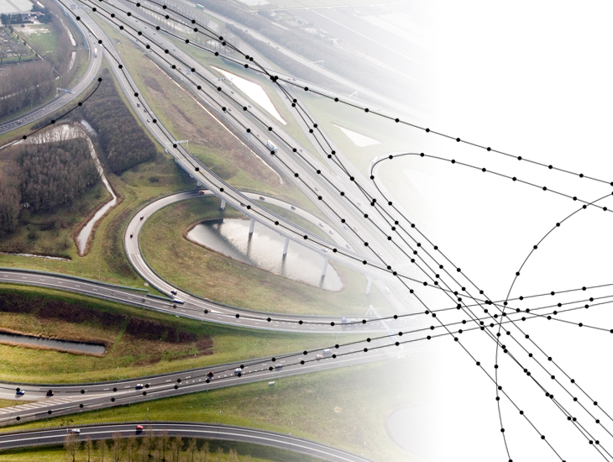
Motivation What is NWB?
Stands for Nationaal Wegenbestand
Produced and maintained by Rijkswaterstaat via NDW (Nationaal Dataportaal Wegverkeer)
Commercial “client” of this project
Stand-alone public geospatial product of The Netherlands (open data)
Graph-like representation of all named roads of The Netherlands
https://nationaalwegenbestand.nl/wat-het-nwb
Notes:
Does NL already have such a dataset?
Produced and maintained by Rijkswaterstaat via division “NDW”
They are the commercial “client” of this project
Graph-like representation of all named roads in The Netherlands
Graph properties, but technically an ESRI Shapefile
Knoppunten: real-life intersections, i.e. graph nodes
Wegwakken: road centreline segments, i.e. graph edges

Slide 5
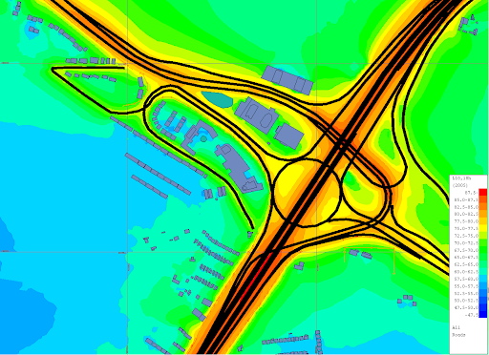
Motivation Purpose of georeferencing
In general:
We can relate the road to its physical surroundings – required in many applications
In this specific case:
This project is relevant to noise modelling
→ Need to know geographical source of noise
http://www.noisemap.ltd.uk/wpress/features/roads/
Notes:
Possible to relate the road to its surroundings
Can work with external information, e.g. addresses in route planning
Our scenario: NWB is used as traffic noise source in propagation model, exact geographical source of noise needs to be known

Slide 6
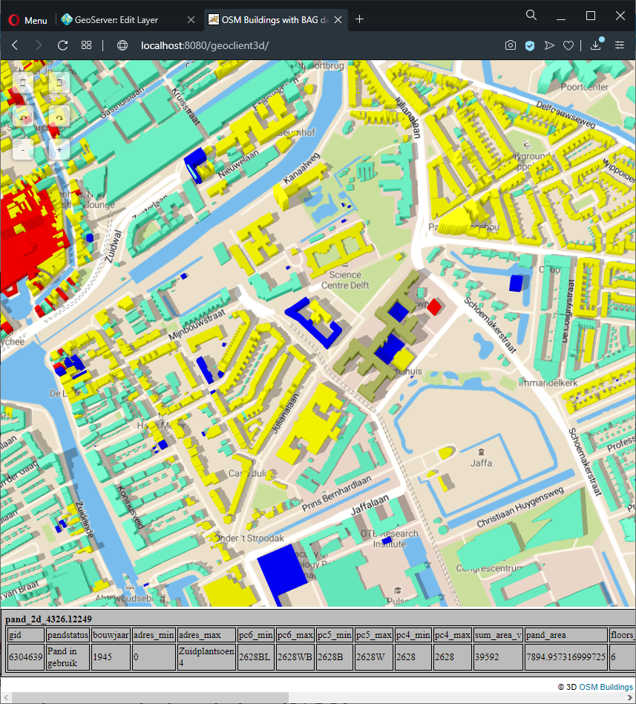
Motivation Justifying 3D georeferencing
In general:
3D distances cannot be measured if (part of) model is 2D
Some applications may require 3D distances
In our specific case:
Traffic noise modelling traditionally done in 2D
But… propagating traffic noise in a 3D model is more realistic, more accurate
Notes:
2D models do not allow 3D distances to be measured
E.g. the distance of road on a bridge from an object on the terrain below
Traffic noise modelling traditionally done in 2D
E.g. elevated roads propagate noise far away, but sunken roads not so far away
But 3D is far more realistic and accurate

Slide 7
Motivation Problem
New Dutch noise legislations require traffic noise modelling to be carried out in 3D
NWB is a 2D dataset – if it is to keep its relevance, it needs to be transposed into 3D – but…
… road elevations cannot be sensed remotely with arbitrary accuracy.
… road elevations cannot be sensed locally with good enough cost-efficiency.
Notes:
NWB is a 2D dataset
Needs to be transposed to 3D so that it stays useful for noise modelling,
… in a way that output is up to noise legislations’ accuracy requirements
Cannot be directly remote-sensed with arbitrary accuracy, e.g.
Cannot penetrate into tunnels
Difficult to sense 3D relationships due to occlusion
Cannot be locally sensed with good enough cost efficiency
Examples: MLS, manual surveying, GPS cars
Very expensive, traditionally used for small-scale projects

Slide 8
Motivation Problem
A commercial implementation exists (completed December 2020). However…
… accuracy quantification is missing from it.
… it uses pragmatic methods, i.e. robustness and completeness are valued above all else.
Notes:
Commercial implementation exists
Extracts road elevations from Dutch open data
There are issues
It lacks an accuracy quantification workflow
It favours robustness and completeness, sacrificing
Scientific correctness
Accuracy
Performance
Innovation

Slide 9
Constructing a digital 3D road network for The Netherlands Research questions
Two main aspects:
How to convert NWB into a 3D road model using geomatics methods?
How to guarantee that it meets prescribed levels of accuracy?
Examine from mixed scientific-commercial perspective, with emphasis on scientific
Both aspects can be expanded into a range of sub-questions
Notes:
Two main areas of interest for this dissertation:
How to convert NWB into a 3D road model using geomatics methods?
How to guarantee that it meets prescribed levels of accuracy?
Both aspects to be explored from a mixed scientific-commercial perspective
Emphasis on scientific

Slide 10
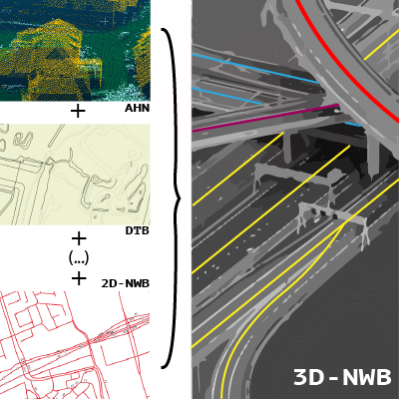
Constructing a digital 3D road network for The Netherlands Research questions
In summary:
“How can we achieve a 3D conversion of the NWB dataset using Dutch open geospatial data and primarily 2.5D*-based surface modelling methods, while guaranteeing optimal and quantifiable accuracy and completeness?”
*2.5D models: all horizontal positions are associated with one, and only one Z value
Notes:
Summary research question of dissertation project
Will decompose road network into small surface models to resolve 3D “conflicts” (among other reasons)

Slide 11
Constructing a digital 3D road network for The Netherlands Preliminary analysis
Input assessment
Literature review
Production of testing datasets

Slide 12
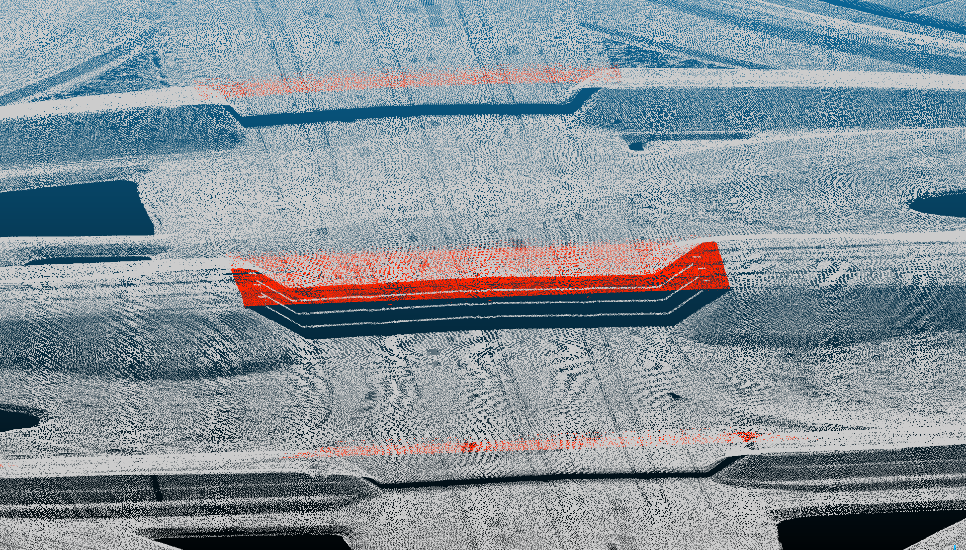
Preliminary analysis Input assessment
Selected AHN3 point cloud as the primary elevation source
Actueel Hoogtebestand Nederland – national ALS dataset
Notes:
Mainly examined Dutch open data
Accessible
Commercial implementation also uses it
AHN3 (national ALS dataset) point cloud to be main elevation source
Accurate
Has good coverage (penetrates vegetation)
Classified
Other candidate was Kadaster’s dense image matching point cloud
Not open data
Less accurate by definition
Image shows AHN3 at a motorway interchange with overpass
Ground-classified points are white, bridges are red

Slide 13
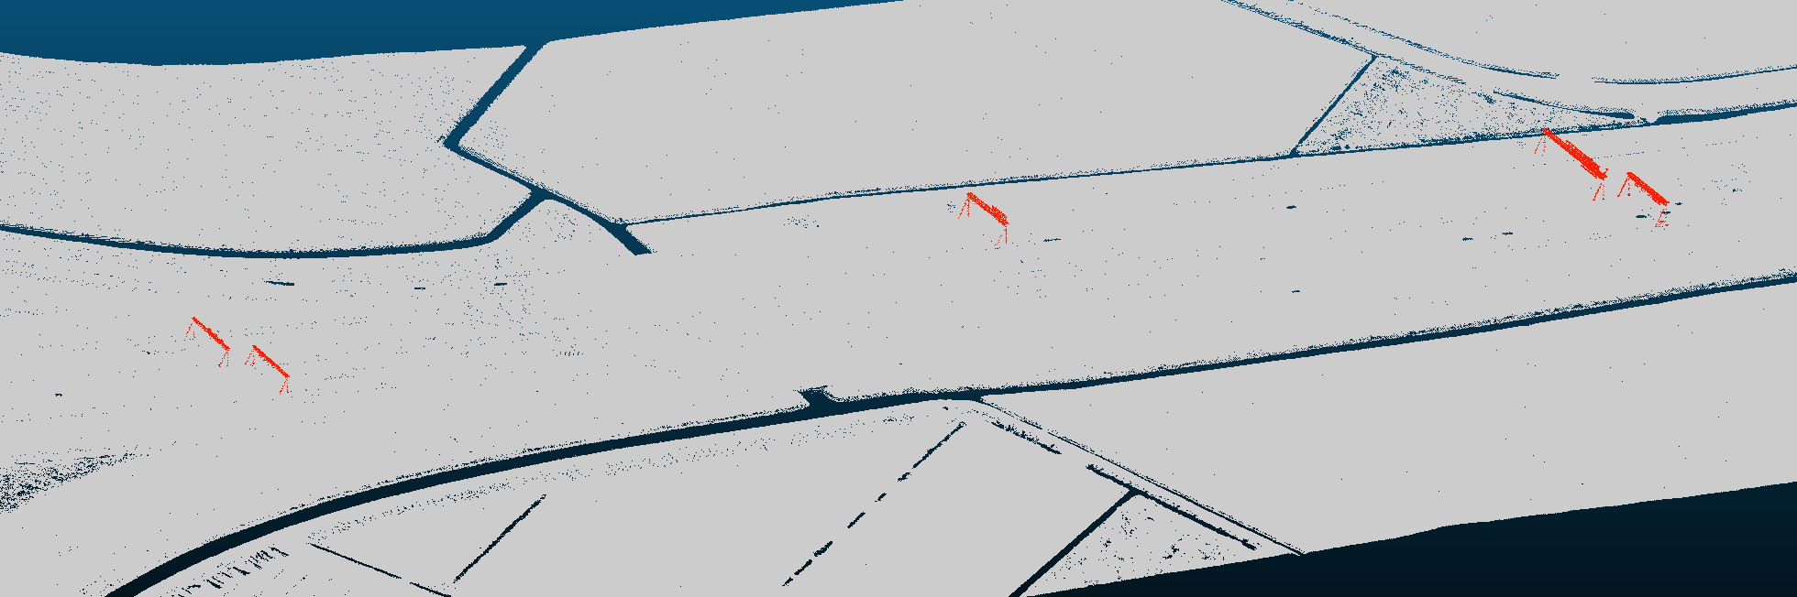
Preliminary analysis Input assessment
Notes:
Further image of AHN3 point cloud
Cropped to buffered NWB extents, bridge classification also includes motorway signs

Slide 14
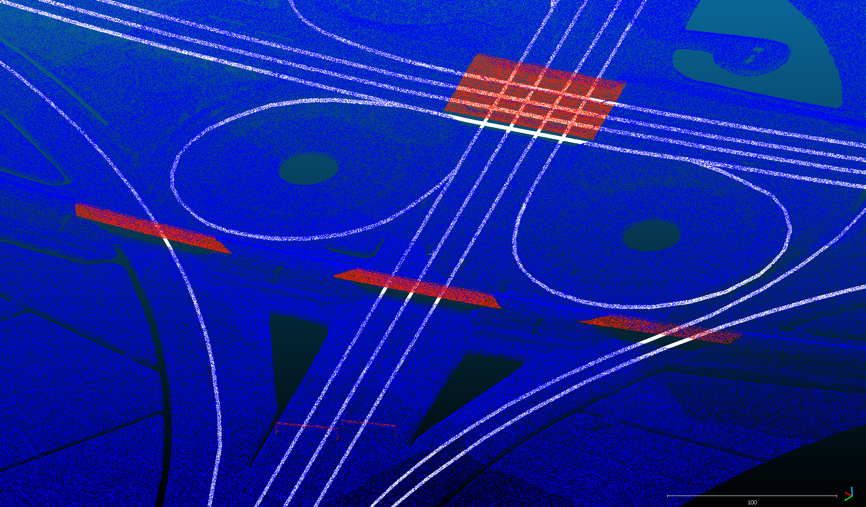
Preliminary analysis Input assessment
Notes:
Further image of AHN3 point cloud, different colour coding, NWB overlain with AHN3
Correspondence not bad, but they are often not in the centre of roads as imaged by Lidar, and may even leave their surface

Slide 15
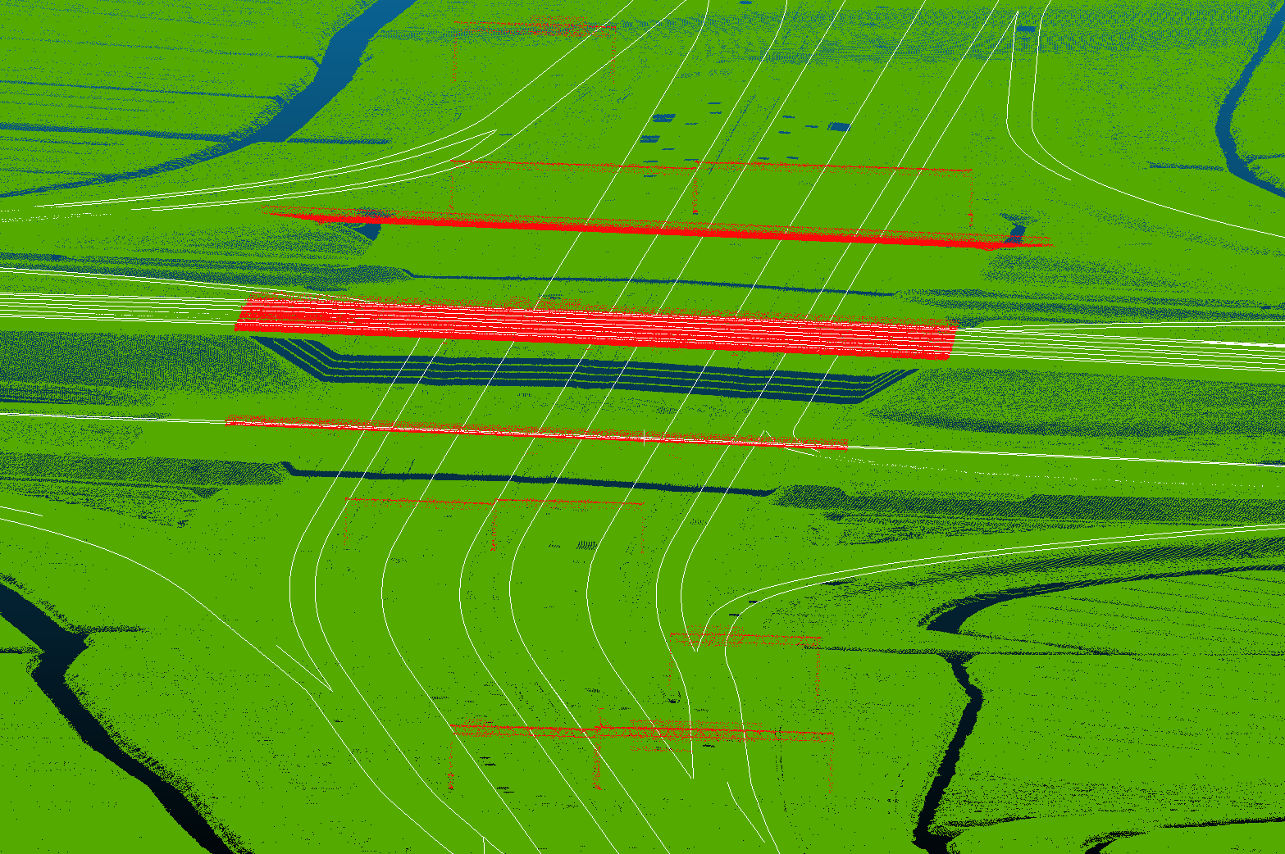
Preliminary analysis Input assessment
Selected DTB as a secondary data source
Digitaal Topografisch Bestand – national infrastructure management dataset
Notes:
DTB (national infrastructure management dataset) planned to be secondary input dataset
Its road dataset only exists for motorways
We are also interested in provincial roads
Derived from various remote + local sensing methods
Accuracy undocumented
3D vector geometries of road features, e.g. painted road edge lines
Image shows DTB overlain with AHN3 in motorway interchange
Only road-edge DTB lines are shown

Slide 16
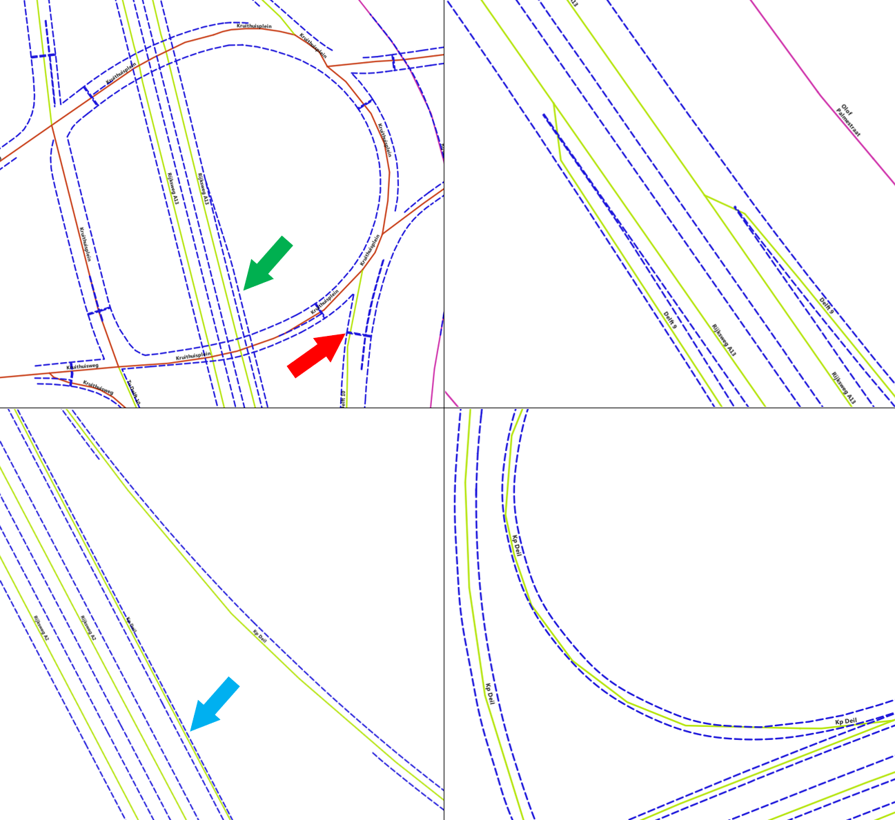
Preliminary analysis Input assessment
NWB needs to be enriched with elevations, but not displaced laterally
However, NWB’s georeferencing can often be (relatively) inaccurate
Notes:
NWB needs to be transposed without lateral displacement
NWB shows deviations with respect to other datasets (including DTB and AHN3)
Worst performance in bends, especially around motorway ramps
NWB often close to road edges or off the road
Image illustrates the above issues with respect to DTB

Slide 17
Preliminary analysis Literature review
Based on the understanding that AHN3 will serve as the primary source of elevation data
Two main areas of interest:
Lidar accuracy + Lidar-based surface model interpolation accuracy
Road feature extraction (and accuracy) from Lidar input data
Notes:
Based on…
AHN3 point cloud serving as the main source of elevation data
Planned use of surface modelling (2.5D methods)
Two main areas of interest:
Lidar accuracy + Lidar-based surface model interpolation accuracy
Road feature extraction (and accuracy) from Lidar input data
We intend to identify road reflections before obtaining elevation values

Slide 18
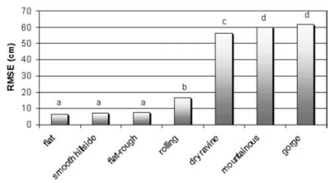
Preliminary analysis Literature review
Lidar accuracy
Strongly depends on survey accuracy descriptors
Also depends on geographically variable factors
Lidar-based DTM/DSM accuracy
Good/bad interpolation methods can only be defined in terms of terrain features and scale
Three options: formal error propagation, Monte Carlo methods, statistical analysis
Aguilar et al. 2005
Notes:
Lidar accuracy
Depends on survey/equipment descriptors
Depends on geographically variable factors, e.g. terrain complexity
Figure shows increasing RMSE values for terrain features with increasing vertical complexity (e.g. mountainous areas)
Lidar-based surface model interpolation
No absolute ranking between interpolators, each suitable for different purposes
Errors can be propagated formally, using mathematical formulae
OR error propagation can be estimated using Monte Carlo methods
OR accuracy can be estimated using purely statistical tools

Slide 19
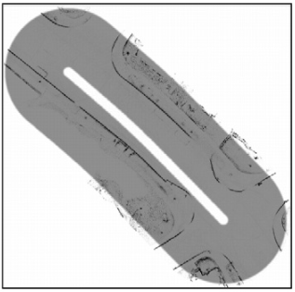
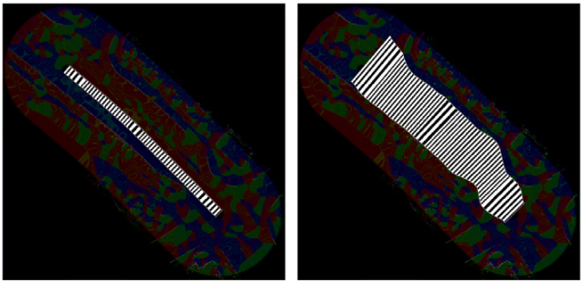
Preliminary analysis Literature review
Road feature extraction from Lidar input data…
… can be done directly from Lidar data
… can be done using Lidar + external vector data
This is the direction of research I will follow in my project
External data: NWB (and possibly DTB)
Attractor map
Initialised active contour
Optimised active contour
Boyko and Funkhauser 2011
Notes:
Road feature extraction from Lidar input data
Can be done solely from Lidar data
E.g. via photogrammetry or curb detection
Or other vector data (such as NWB and DTB) can be incorporated
E.g. to pinpoint search region or as seeds for optimisation algorithms
This is the direction of research I will follow in my project
Example algorithm shown in figure: active contour optimisation
Attractor geometries are constructed procedurally (detected road edges)
Initial edge estimates are drawn to attractor geometries via optimisation
Attractor geometries not the only factor, e.g. angularity may be considered

Slide 20
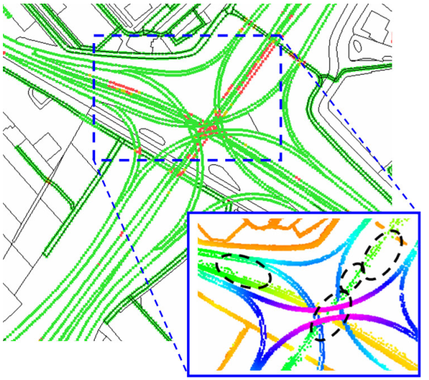
Preliminary analysis Literature review
Road reconstruction quality generally defined in terms of completeness and statistical accuracy
Completeless evaluated w.r.t. reference dataset
Statistical accuracy, e.g. local consistency of elevations (STD, RMSE, etc.)
May take into account formal source accuracy
Oude Elberink and Vosselman 2012
Notes:
Reconstruction quality: completeness + accuracy
Completeness evaluation needs reference dataset(s)
Accuracy (consistency) evaluation may be done independently
E.g. neighbourhood consistency via STD or RMSE (as shown in figure)
May take into account source Lidar accuracy and support
This is shown in the inset of the figure
Sparse, inaccurate Lidar points → low RMSE in road model

Slide 21
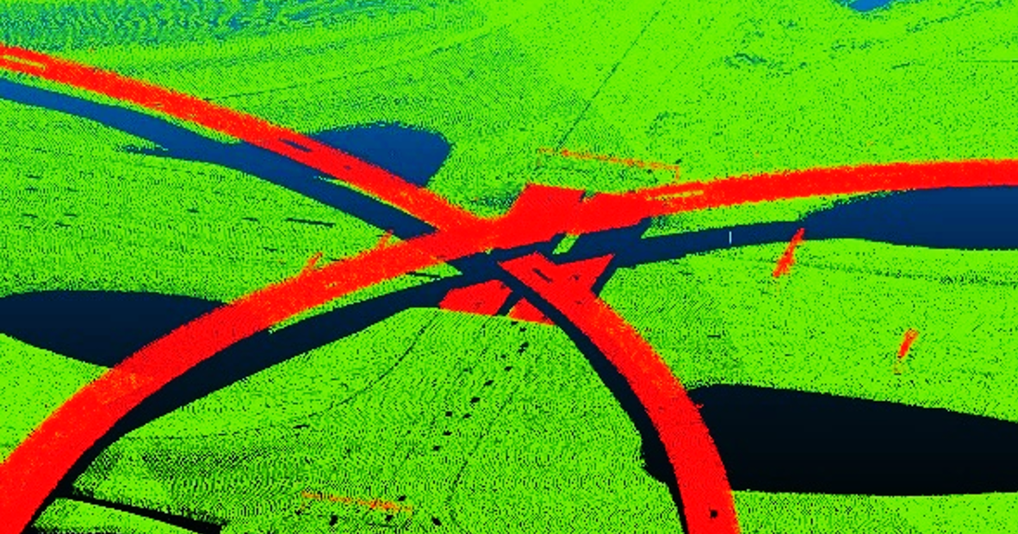
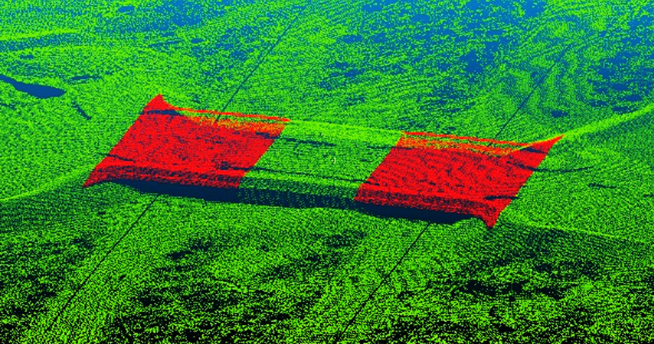
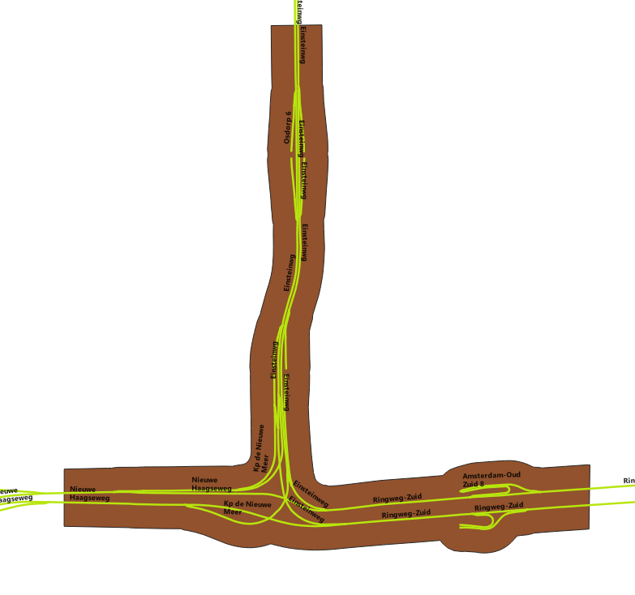
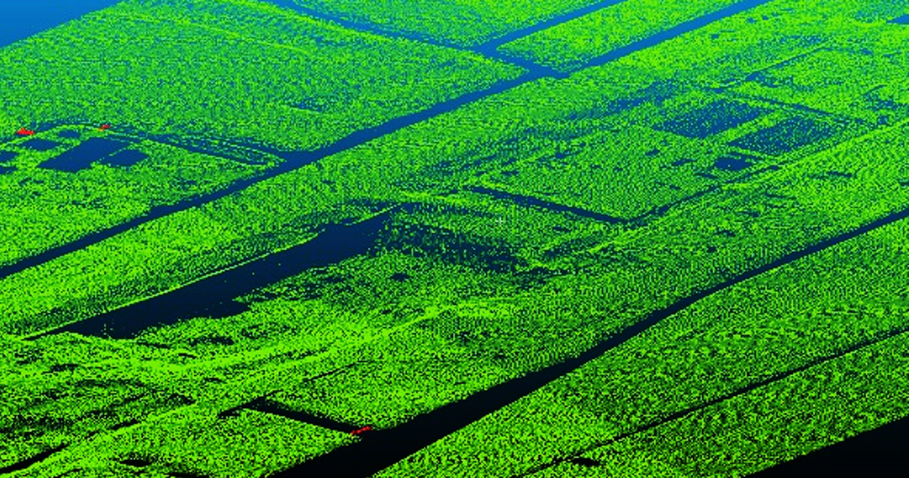
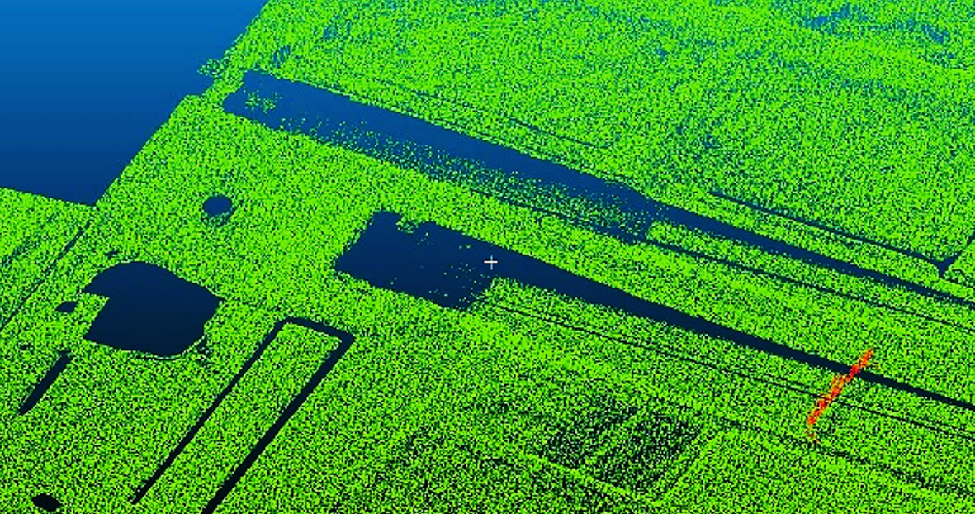
Preliminary analysis Production of testing datasets
Development and testing requires representative subsets of the data
Motorway interchange with 4 levels (Knoppunt Ridderkerk)
Wide green bridges above motorway in forest (A1 in Veluwe)
Example of geometries underlying the point cloud cropping workflow
Sunken motorway/tunnel under construction (near Ketheltunnel in Rotterdam)
Motorway tunnel (Coentunnel in Amsterdam), entrance shown
Notes:
Development and testing requires representative subsets of the data
Workflow: points within cropped, 150-metre buffered extents of short NWB segments kept
Examples:
Multi-level motorway interchange
Dense forest with wide green bridges (occlusion)
Road sensed during construction
Tunnel entrance / tunnel

Slide 22
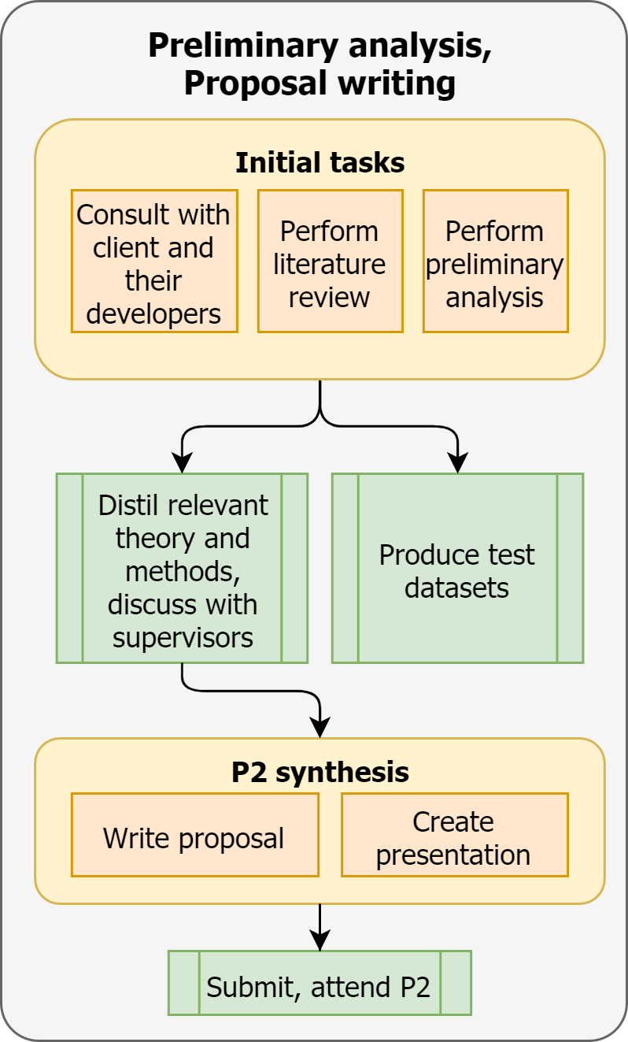
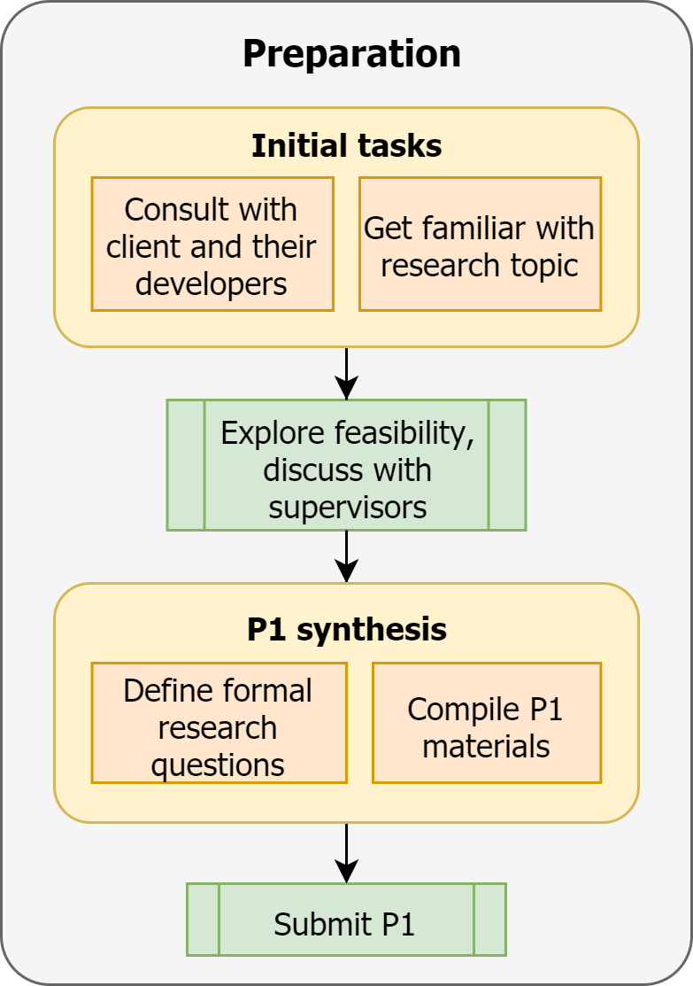
Constructing a digital 3D road network for The Netherlands Methodology
Done in Q1
Done in Q2
Notes:
Preparation (P1) involved:
Consulting with client and their developers, getting familiar with topic
Exploring feasibility and defining project with supervisors
Preliminary analysis and graduation plan writing (P2) involved:
Performing preliminary analysis (input assessment, literature review, production of testing datasets)
Keeping close eye on commercial development
Creation of an initial approximation of the planned workflow itself (see graduation plan)
It will be iteratively refined

Slide 23
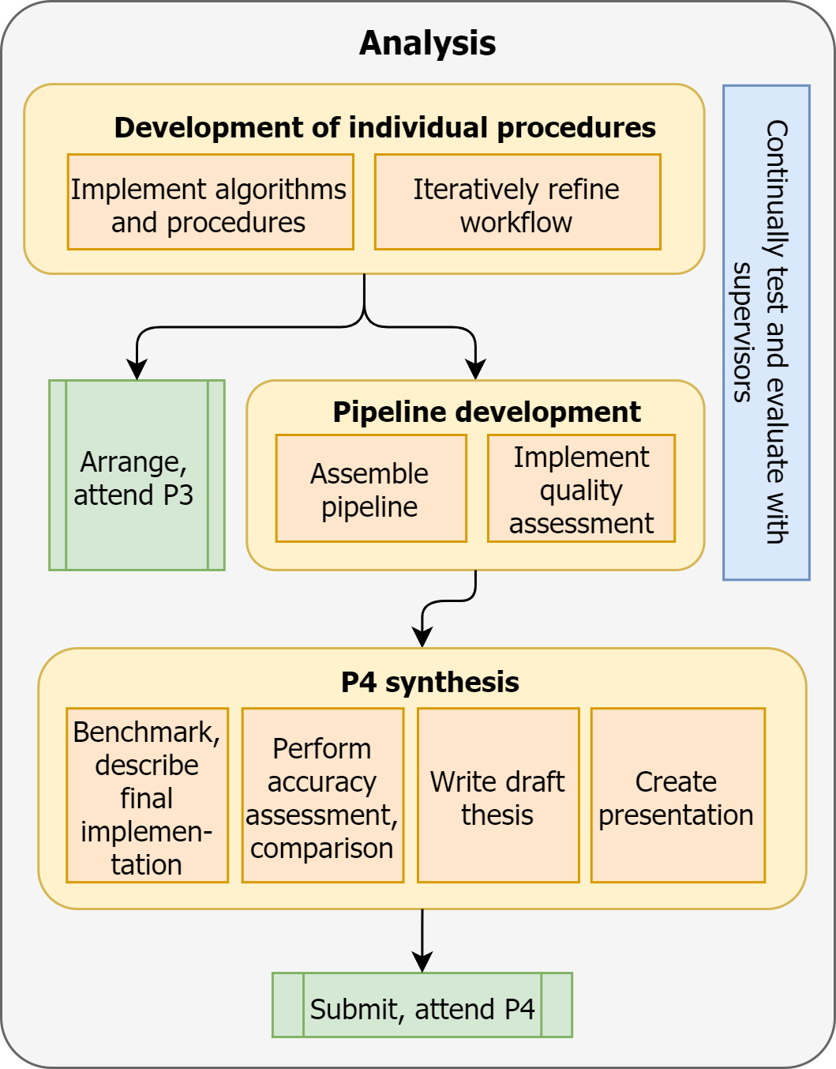
Constructing a digital 3D road network for The Netherlands Methodology
Scheduled for P2-P4 period
Done in Q2
Notes:
Analysis will involve:
Development of individual modules and assembly of pipeline afterwards
Continual (iterative) refinement of workflow during implementation
Benchmarking, focusing on accuracy assessment

Slide 24
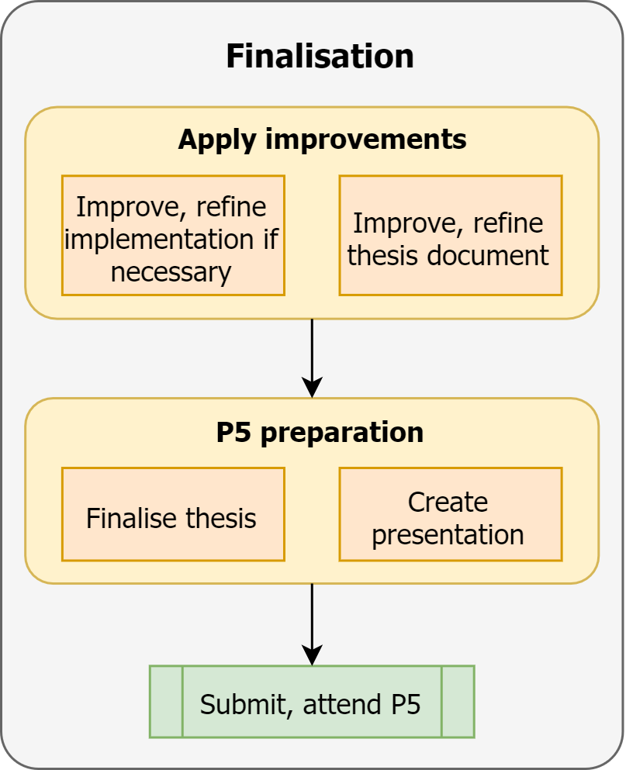
Constructing a digital 3D road network for The Netherlands Methodology
Scheduled for P2-P4 period
Scheduled for P4-P5 period
Notes:
Finalisation will involve:
Improving, refining implementation and thesis

Slide 25
Constructing a digital 3D road network for The Netherlands Timeline
 | Graduation year schedule
Stages | Preparation / Courses to attend |  |  |  |  |  |  |  |  |  | P1 | Preparation |  |  |  |  |  |  |  |  | P2 | Development |  |  |  |  |  |  | P3 | Development, thesis writing |  |  |  |  |  |  |  | P4 | Finalisation |  |  |  | P5
Tasks | Attend 3 elective courses |  |  |  |  |  |  |  |  |  | Discuss research goals with NDW |  |  |  | Consult with NDW where needed |  |  |  |  |  | Work on individual procedures of workflow |  |  |  |  |  |  |  |  |  | Assemble procedures into pipeline |  |  |  |  |  | Refine results
 | Discuss project goals with NDW |  |  |  | Discuss project with RHDHV |  |  |  |  |  | Describe RHDHV implementation |  |  |  | Stay up to date on RHDHV progress |  |  |  |  |  |  |  | Final determination of exact methods for individual procedures |  |  |  |  |  | Final determination of pipeline
 |  |  | Explore research topics and feasibility, experiment and discuss with mentors |  |  |  |  |  |  | Perform literature review |  |  | Perform preliminary analysis |  |  | Create test datasets |  |  |  |  |  |  |  |  |  |  |  |  |  |  |  | Focus on accuracy assessment
 |  |  |  |  | Define formal research questions, write project summary |  |  |  |  |  |  |  |  | Write draft proposal |  |  | Finalise proposal |  |  |  |  |  |  |  |  |  |  |  |  |  |  |  |  | Write draft thesis |  |  |  | Finalise thesis
 |  |  |  |  |  |  |  |  |  | Create, submit P1 |  |  |  |  |  |  |  |  | Submit proposal, attend P2 |  |  |  |  |  |  |  |  | Arrange, attend P3 |  |  |  |  |  |  |  |  | Submit draft, attend P4 |  |  |  |  | Submit thesis, attend P5
Week | 36 | 37 | 38 | 39 | 40 | 41 | 42 | 43 | 44 | 45 | 46 | 47 | 48 | 49 | 50 | 51 | 52 | 53 | 1 | 2 | 3 | 4 | 5 | 6 | 7 | 8 | 9 | 10 | 11 | 12 | 13 | 14 | 15 | 16 | 17 | 18 | 19 | 20 | 21 | 22 | 23 | 24 | 25
Year | 2020 |  |  |  |  |  |  |  |  |  |  |  |  |  |  |  |  |  | 2021
Notes:
Gantt-chart-like representation of my entire graduation year
This year, P3 has been converted to a small meeting between supervisors and student
I scheduled the P2-P4 period to be a single period of development
Dates are subject to change (development challenges, unknown P4/P5 schedule)

Slide 26
Constructing a digital 3D road network for The Netherlands T
Thank you for your attention!
Aguilar, F., Aguera, F., M.A., A., and Carvajal, F. ¨(2005). Effects of terrain morphology, sampling density, and interpolation methods on grid DEM accuracy. Photogrammetric Engineering and Remote Sensing, 71:805–816.
Boyko, A. and Funkhouser, T. (2011). Extracting roads from dense point clouds in large scale urban environment. ISPRS Journal of Photogrammetry and Remote Sensing, 66.
Oude Elberink, S. and Vosselman, G. (2012). Quality analysis of 3D road reconstruction. International Archives of Photogrammetry, Remote Sensing and Spatial Information Sciences, 36

Slide 27
Constructing a digital 3D road network for The Netherlands T
Questions

